Slide 1
Chatbot Automation
September 24, 2022

Slide 2
Chatbot Automation
Innovation
Novelty of the Idea
Uses of Service
Making the Process improvement and minimize the manual interve
They provided real-life interactions, better end-user experience, higher productivity, and are cost-effective
Cost Saving Enhance the Customer Engagement Save the time Industry Agnostic

Slide 3
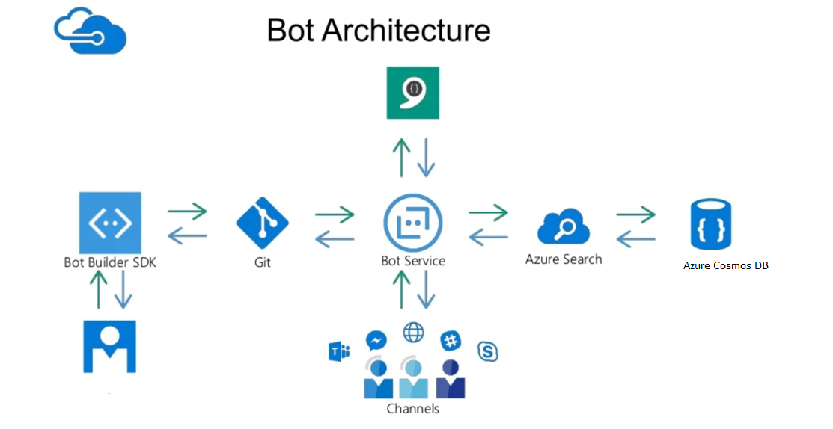

Slide 4
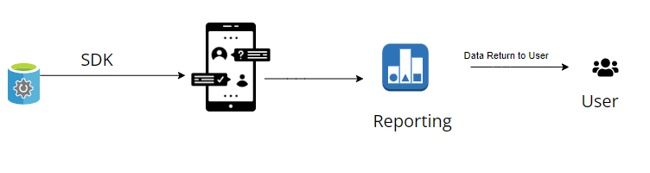
DATA FLOW Diagram
DataBase

